Slide 1
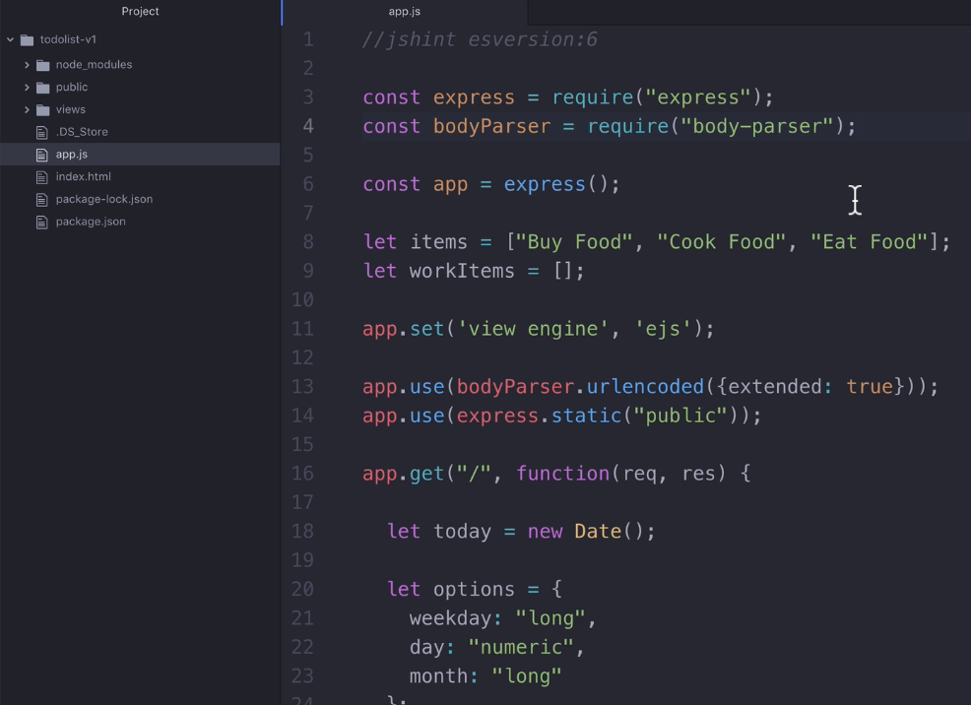
We can do exports in our existing project

Slide 2
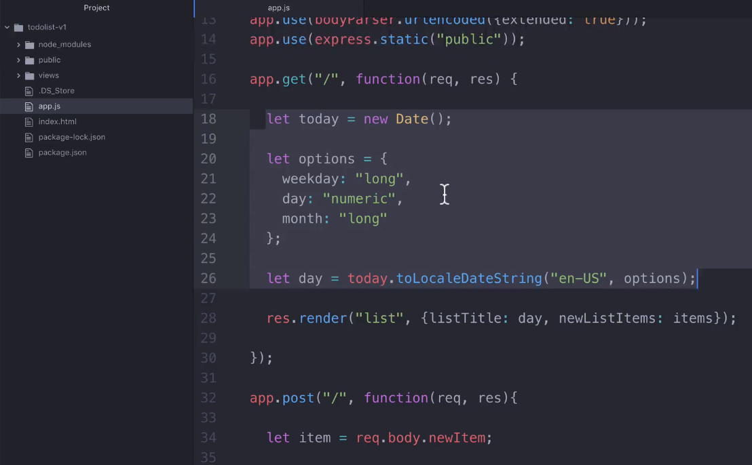
We have to find which part of our code can be exported. It means
re-use it in other part of our code. Here working with date logic.

Slide 3
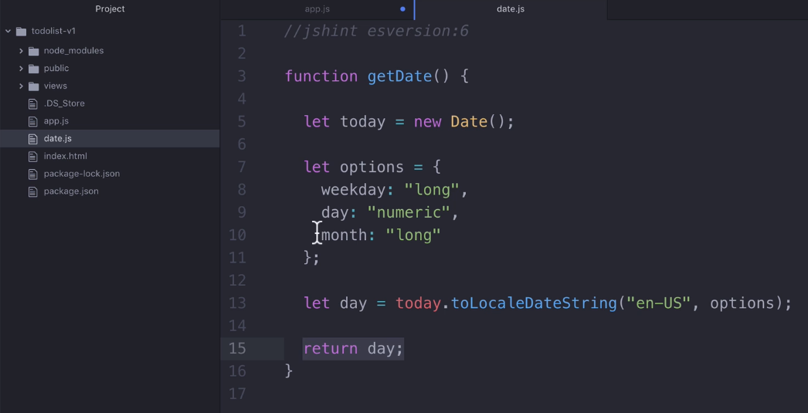
Creating a separate file date.js and doing date logic inside that file.

Slide 4
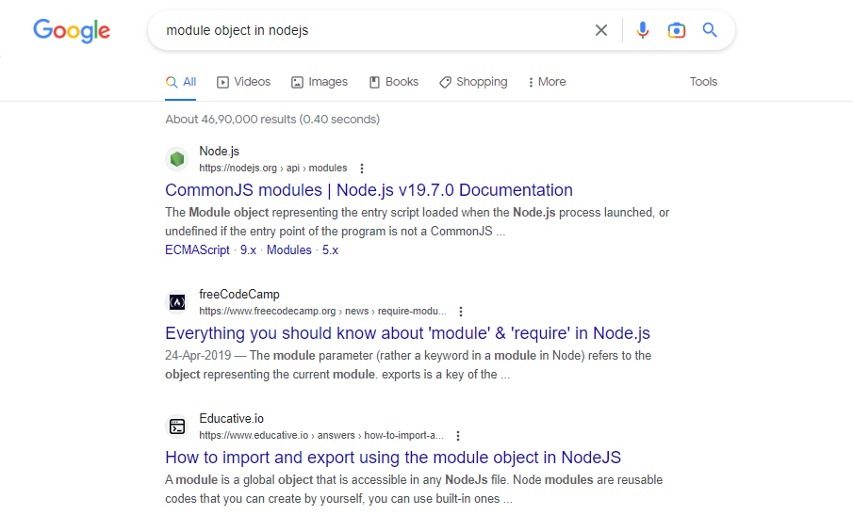
Search: Module object in google

Slide 5
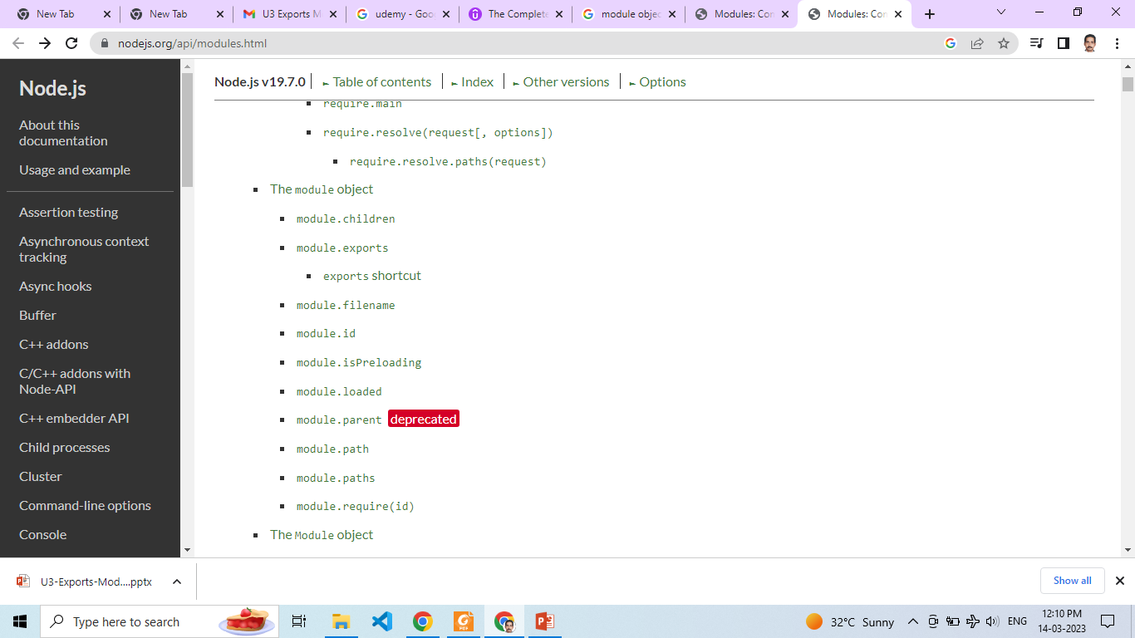
Refer module object’s document page in Node JS site

Slide 6
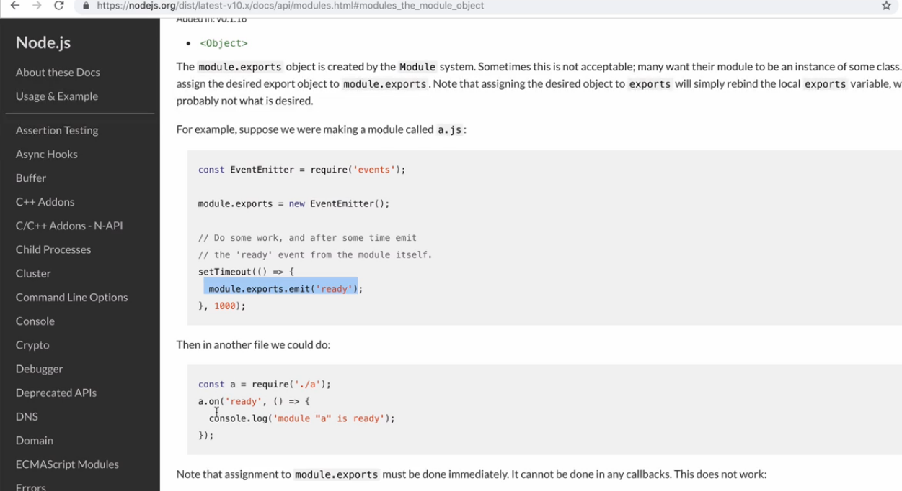

Slide 7
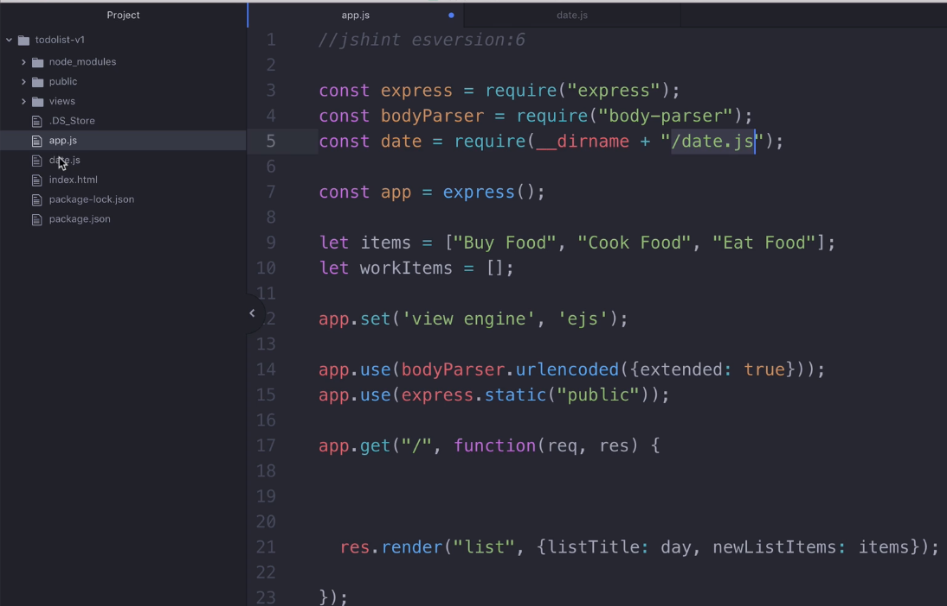
Accessing date.js file at app.js file which is located inside our project folder.

Slide 8
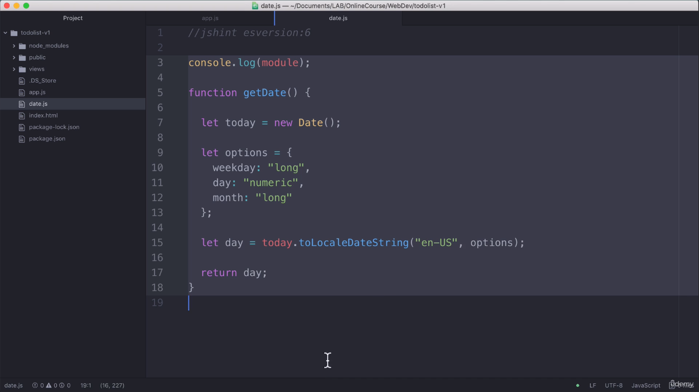
Adding console.log(module) to print module information.

Slide 9
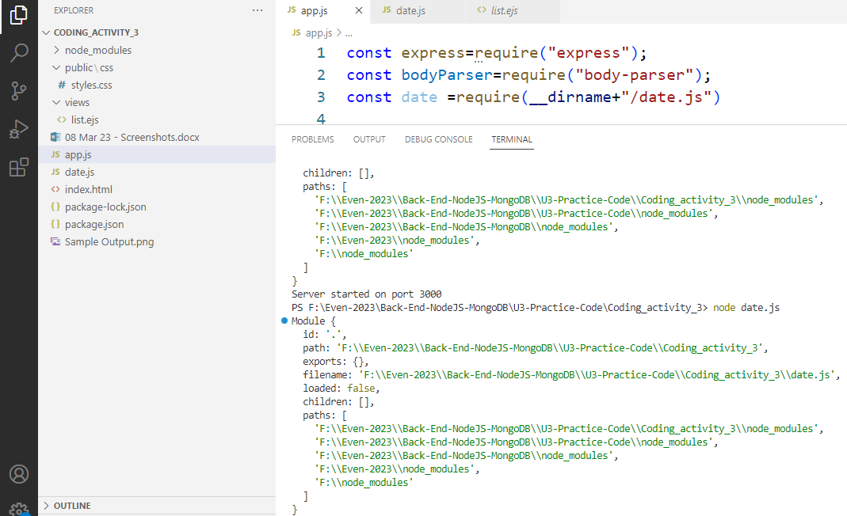
When we run date.js file, we can see exports:{} → looks empty

Slide 10
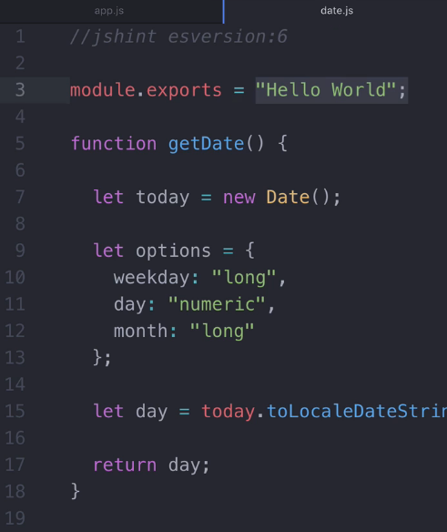
Change console.log(module) to module.exports = “Hello World”.

Slide 11
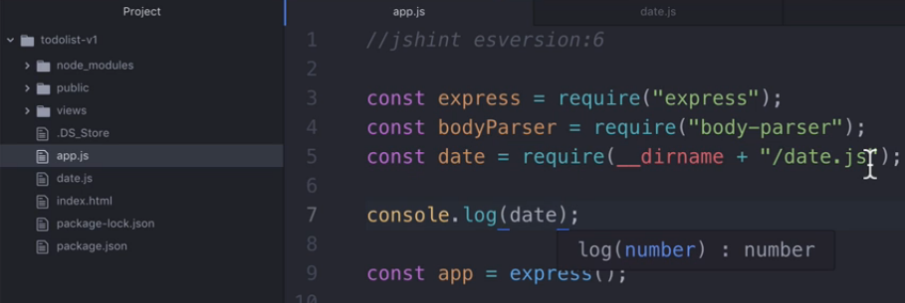
Adding console.log(date) at app.js to print module information.
And check output at console window.

Slide 12
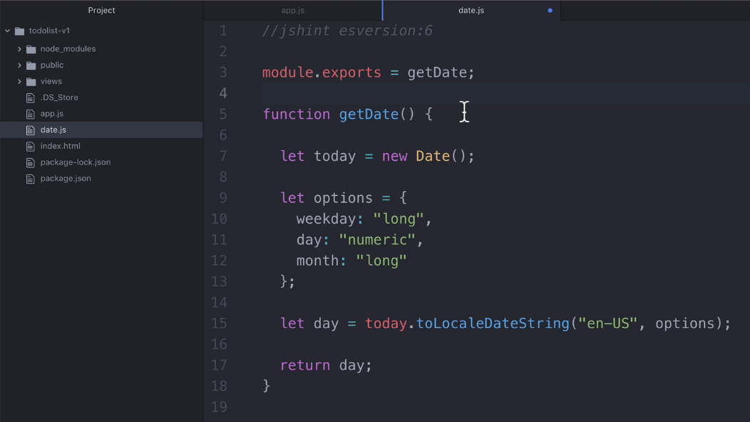
Using module.exports to export our function getDate.

Slide 13
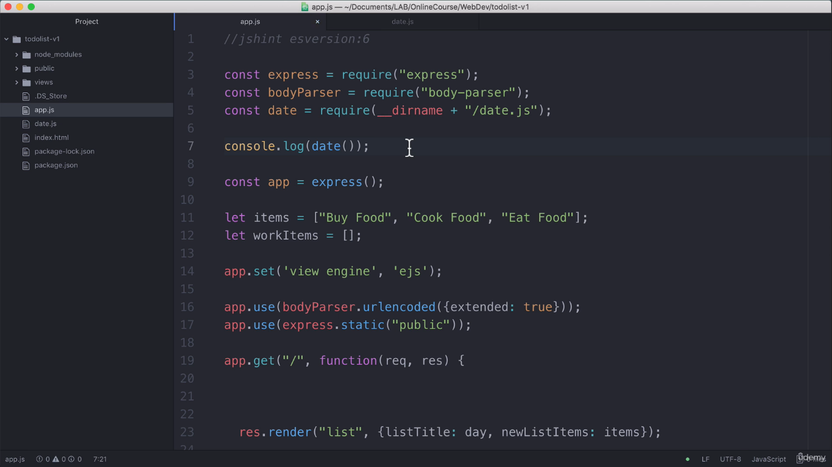
Using require() to import our function getDate at app.js, now inside console.log(date()) with parenthesis, It means we are calling function.

Slide 14
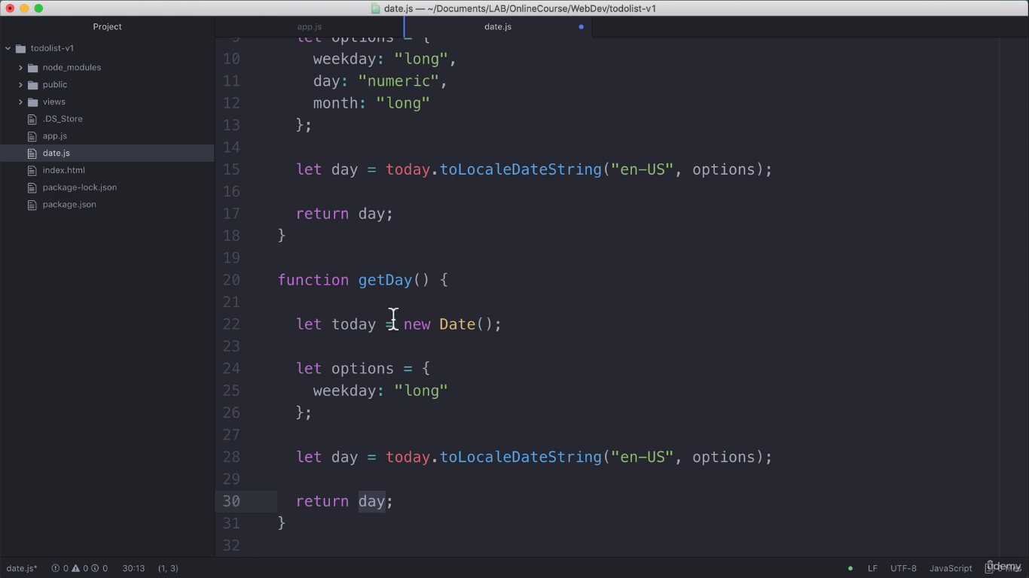
Creating another function getDay() at date.js file

Slide 15
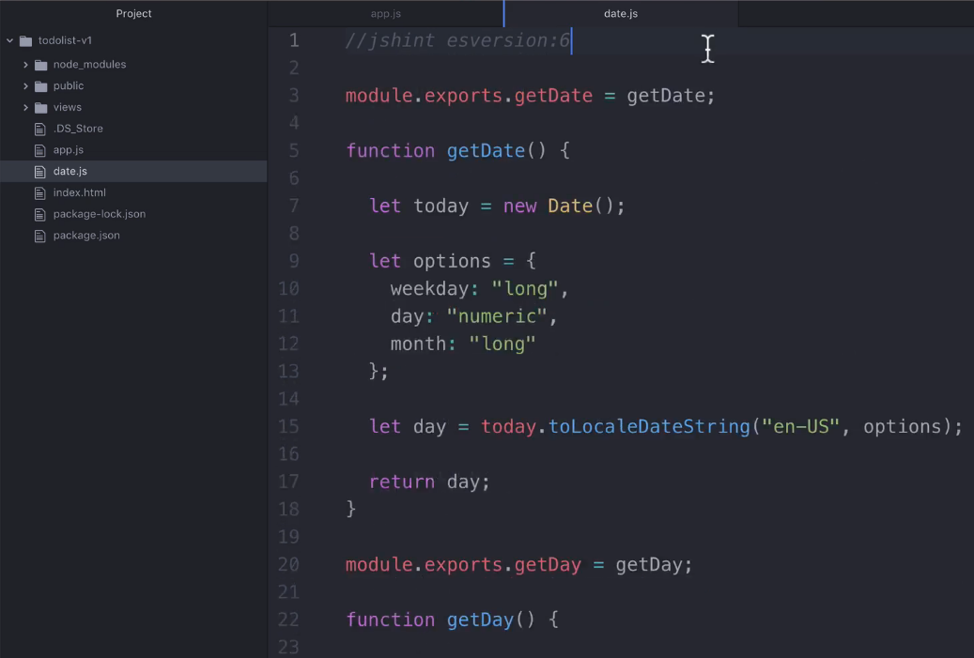
Export getDay() function at date.js file like getDate() function

Slide 16
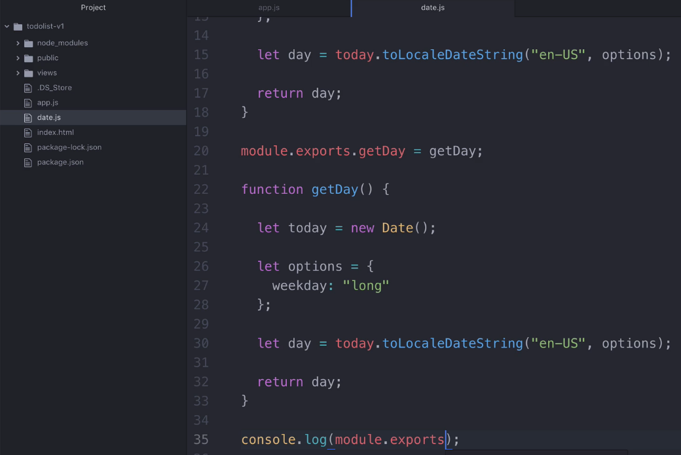
Check module exports using console.log() at date.js file

Slide 17
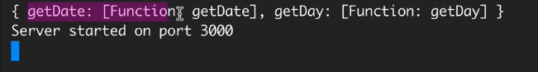
Verifying output at hyper terminal

Slide 18
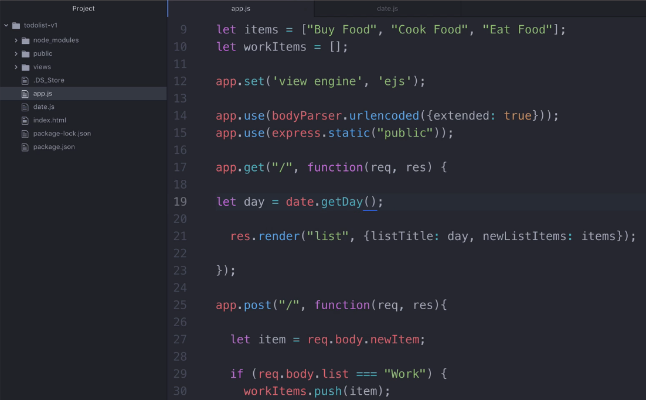
Calling getDay() function at app.js file

Slide 19
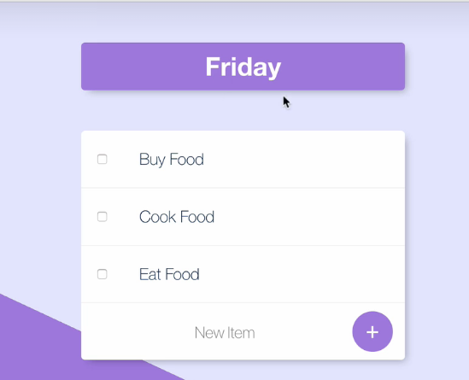

Slide 20
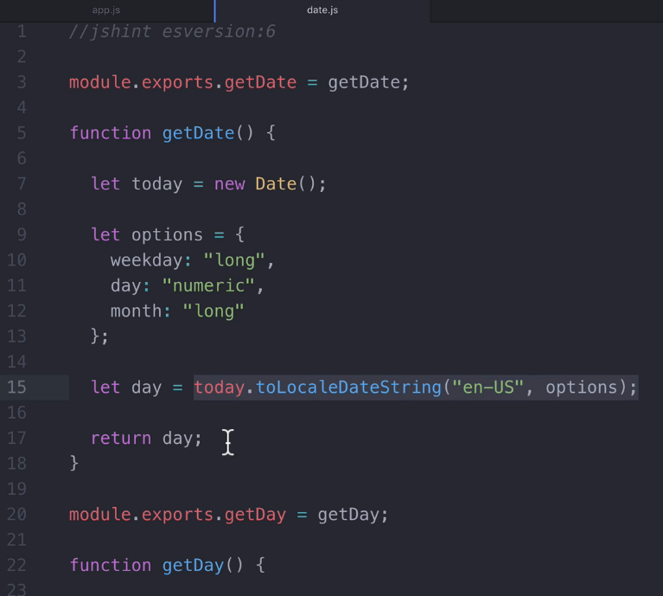
Re factor: Changing line numbers 15 & 17 into single line.

Slide 21
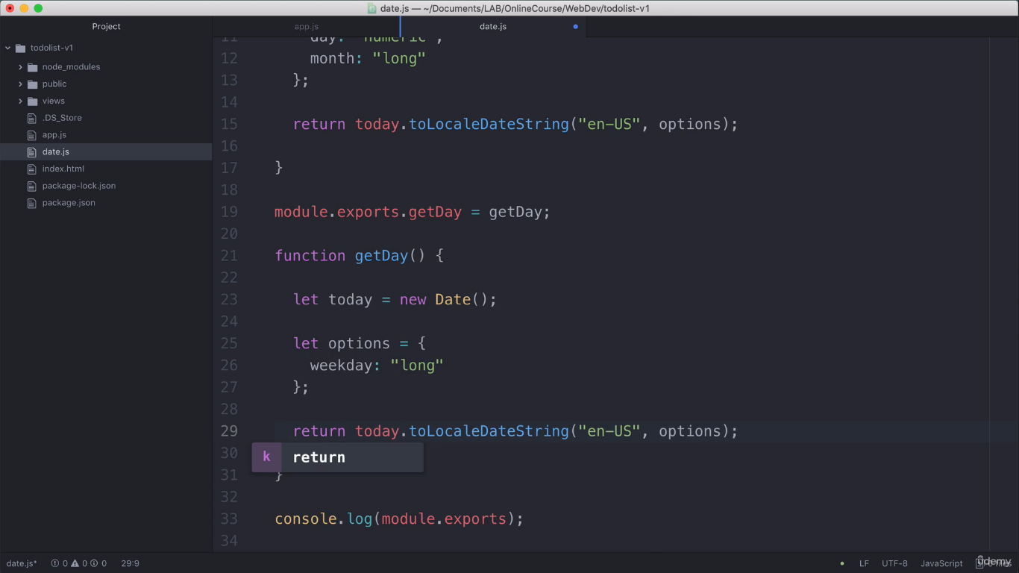
Re factor: Changing line numbers 15 & 17 into single line 19.
Similarly line 29 is changed.

Slide 22
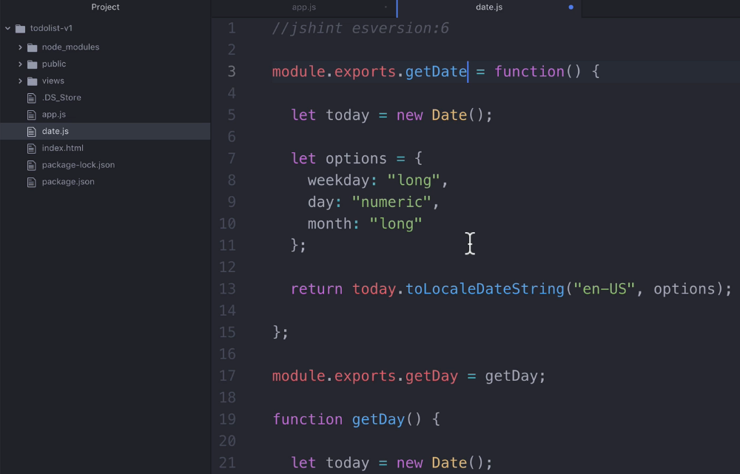
Re factor: change getDate() normal function syntax into anonymous function syntax.

Slide 23
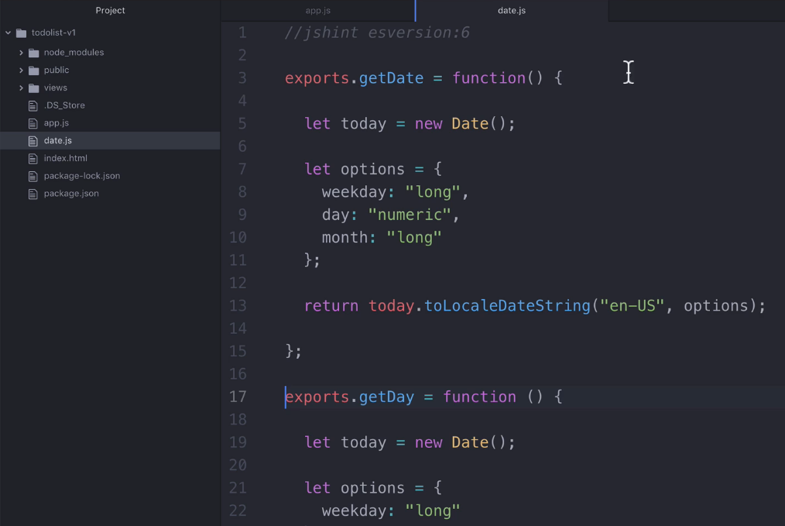
Removing a keyword module , using only exports keyword.

Slide 24
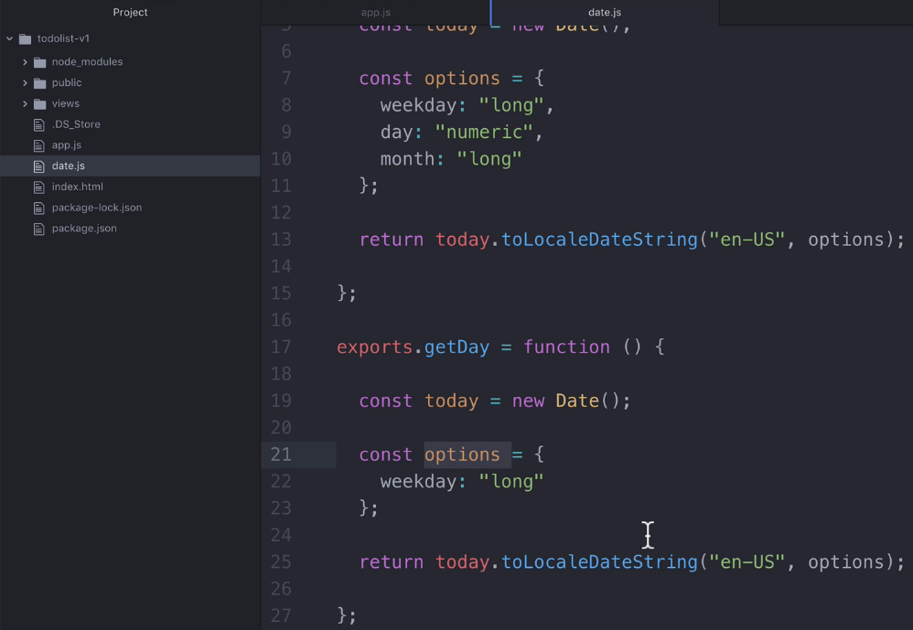
Re factor: Changing a keyword let into const keyword.

Slide 25
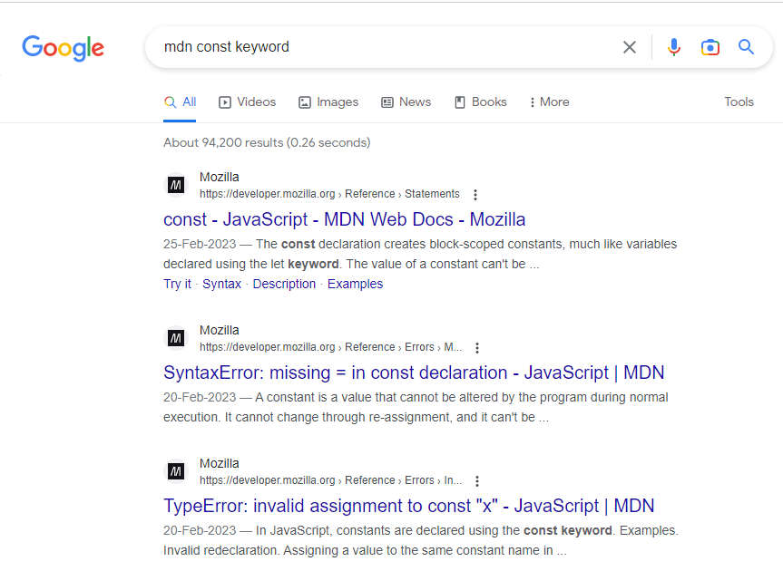
Re factor: Some time Changing a keyword let into const keyword in array variable is raising some doubts. Because array items will be added in future. So Is it possible to use const keyword in Array variables. At Google?

Slide 26
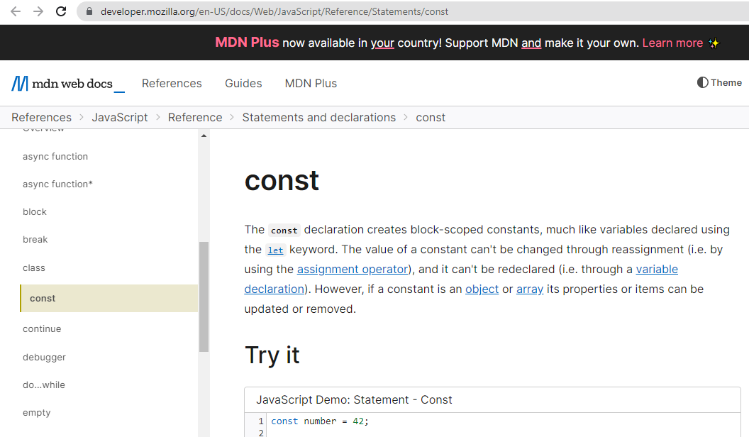
Re factor: mdn const main page

Slide 27
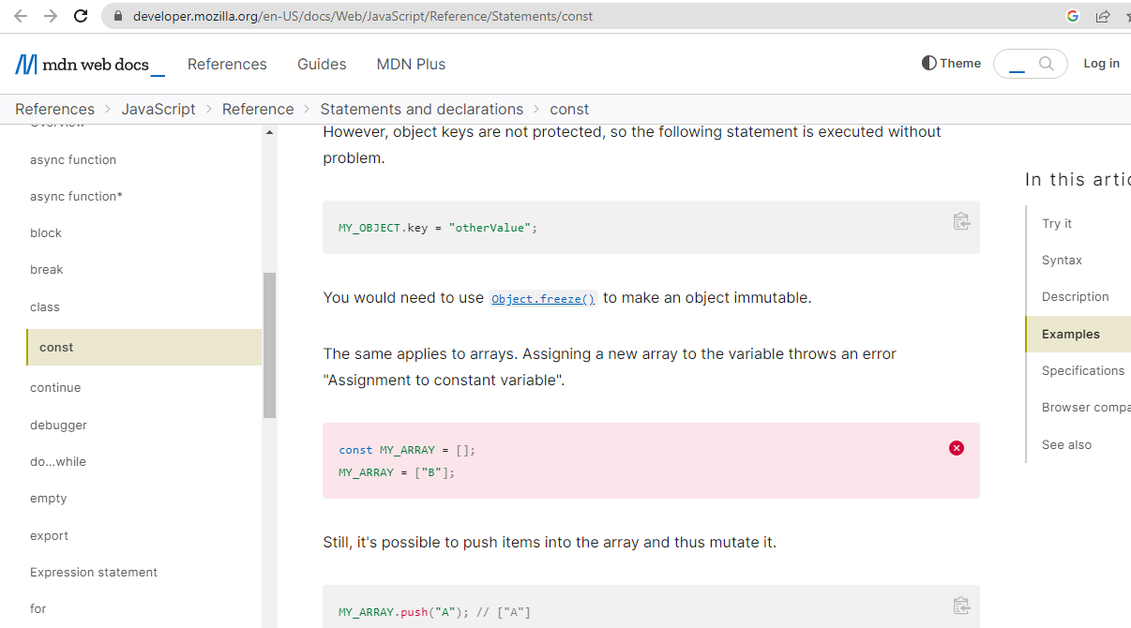
Re factor: mdn const main page – Read Instructions given below

Slide 28
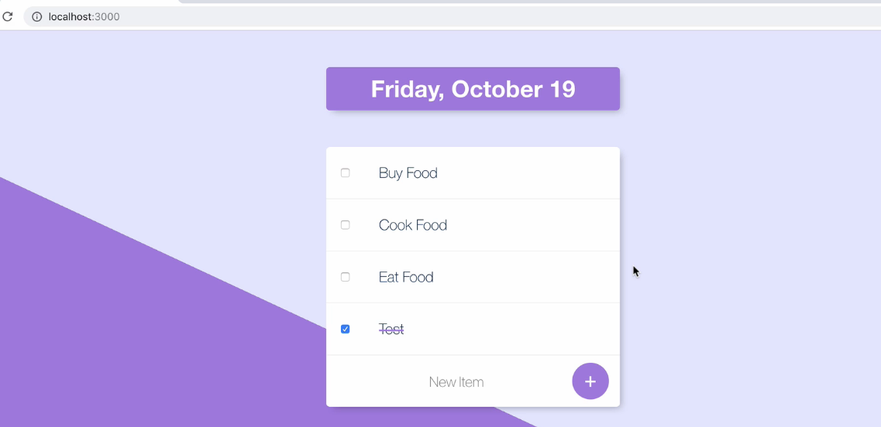
Output Screen after doing some Re factoring TodoList-v1

Slide 29
To know more about What is Code Refactoring?
https://www.bmc.com/blogs/code-refactoring-explained/

